Slide 1
What is Data Science?

Slide 2
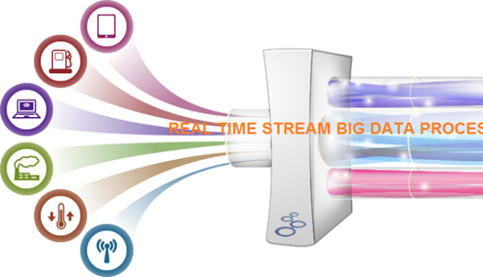
Digital Sensors everywhere
Data Analysis
processing

Slide 3
Two data analysis tasks
Establishing facts:
The water in City X is safe/unsafe to drink.
The average daily time spent on a smartphone is Y
The number of almost accidents per-day on highway 5 is Z
Making predictions:
Selecting ads to maximize clicks.
Automating/assisting medical diagnostics.
Choosing candidates for Loans.

Slide 4
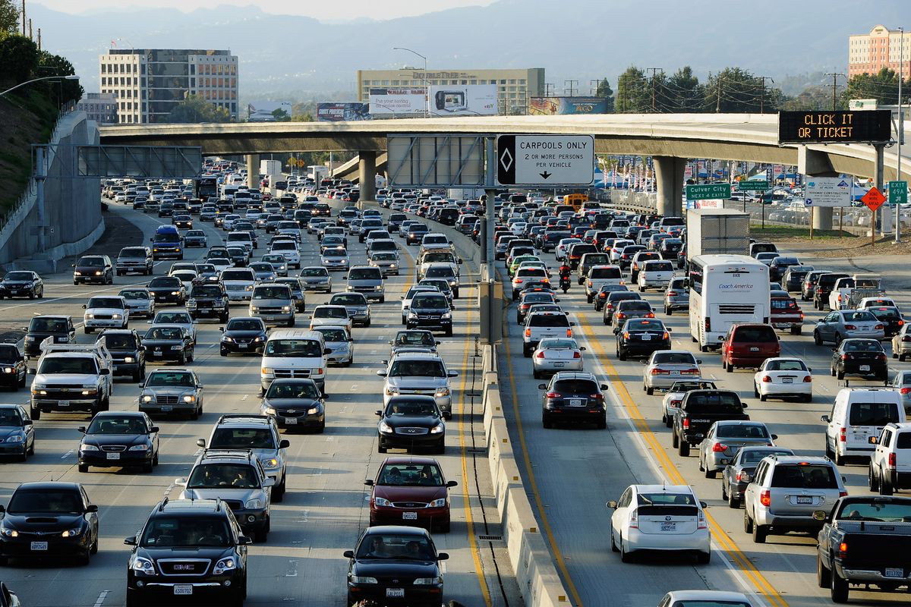

Slide 5
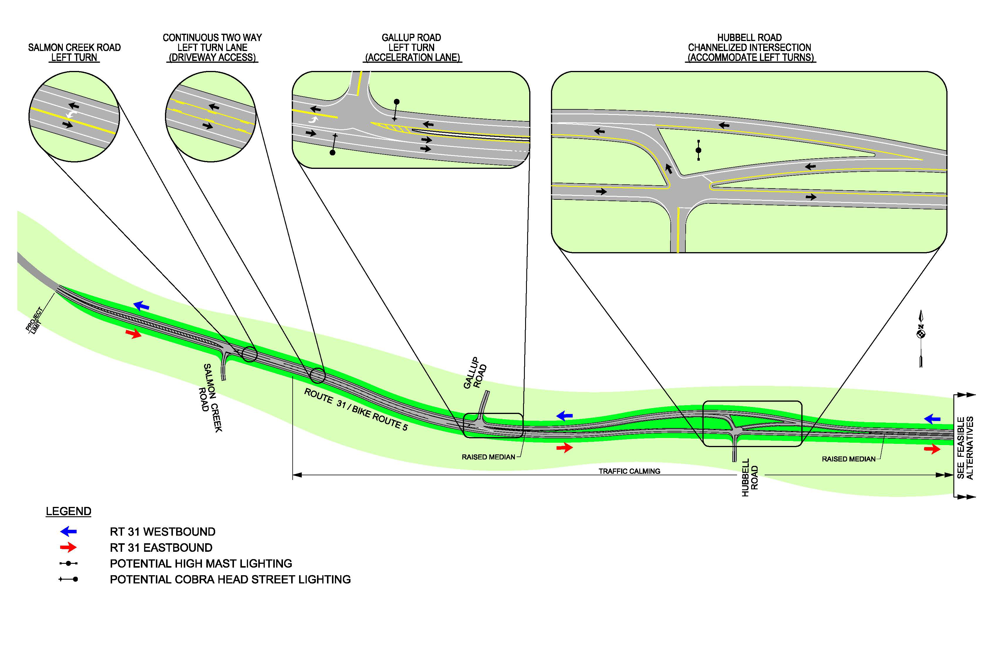

Slide 6
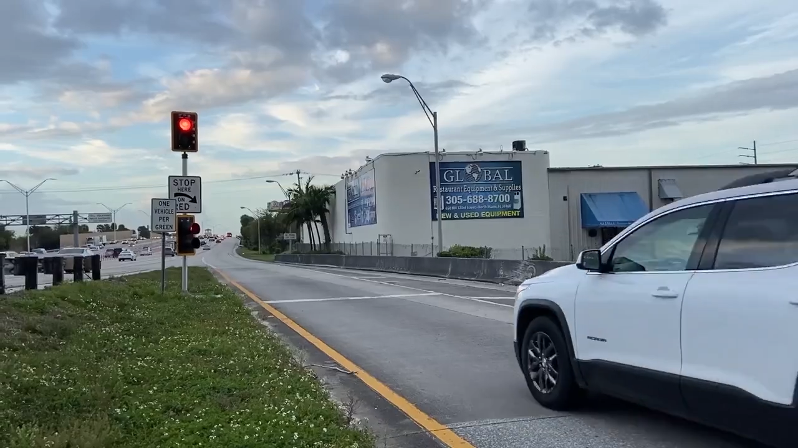

Slide 7
A real life example highway traffic in California.

Slide 8
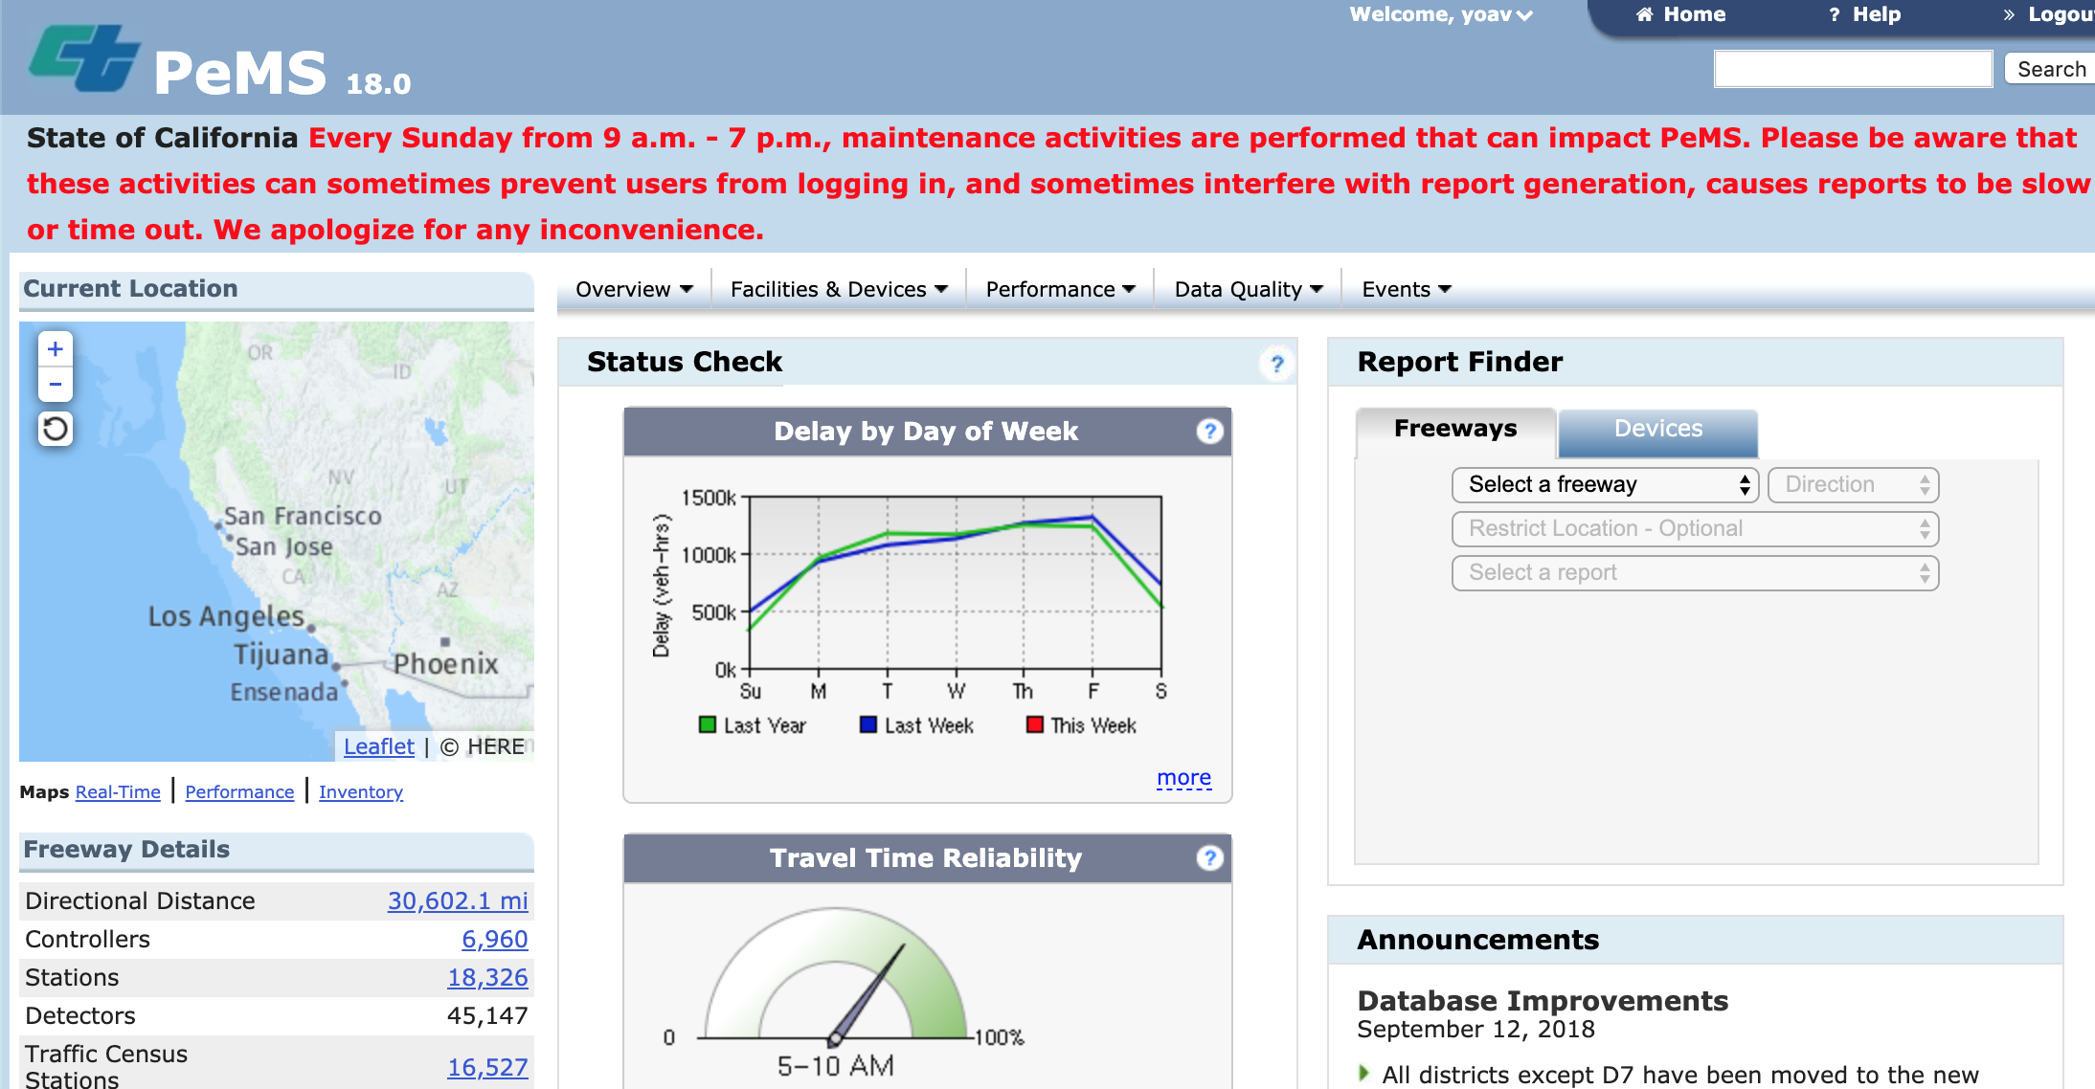
Caltrans: PeMS (Performance measurement system)

Slide 9
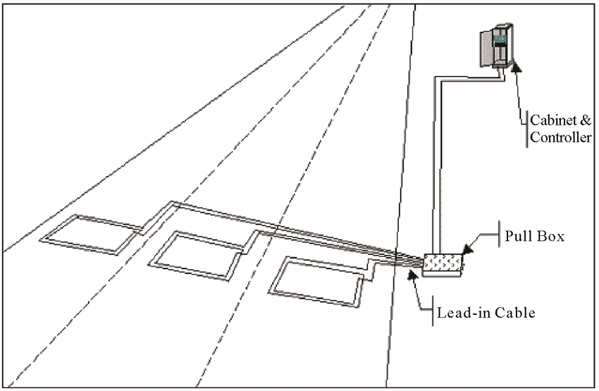
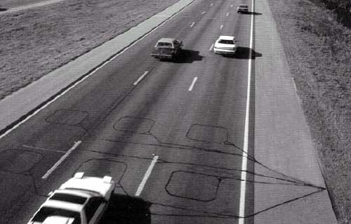
Car Loop Detectors
For each passing car:
flow : number of cars per unit time.
Occupancy: fraction of time that there is a car above the coil.
~45,000 individual detectors.
Each detector generates a data packet every 30 seconds.

Slide 10
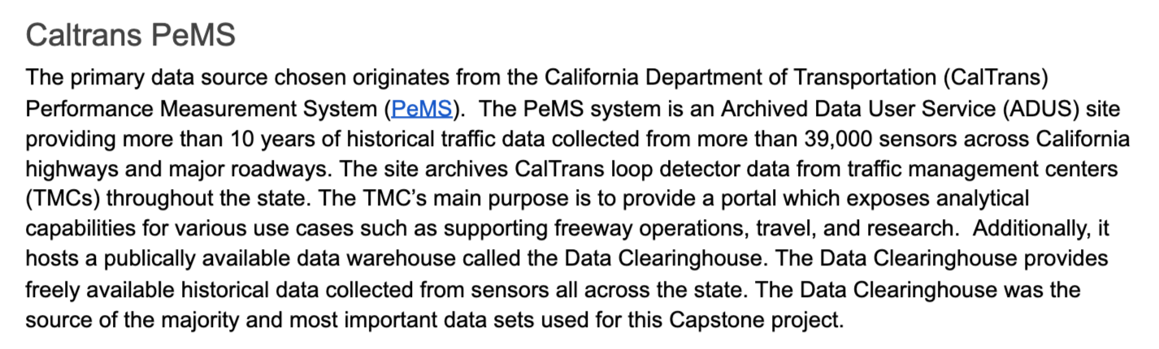
MAS-DSE Capstone Project, 2016 Kevin Dyer, John Gill III, Conway Wong

Slide 11
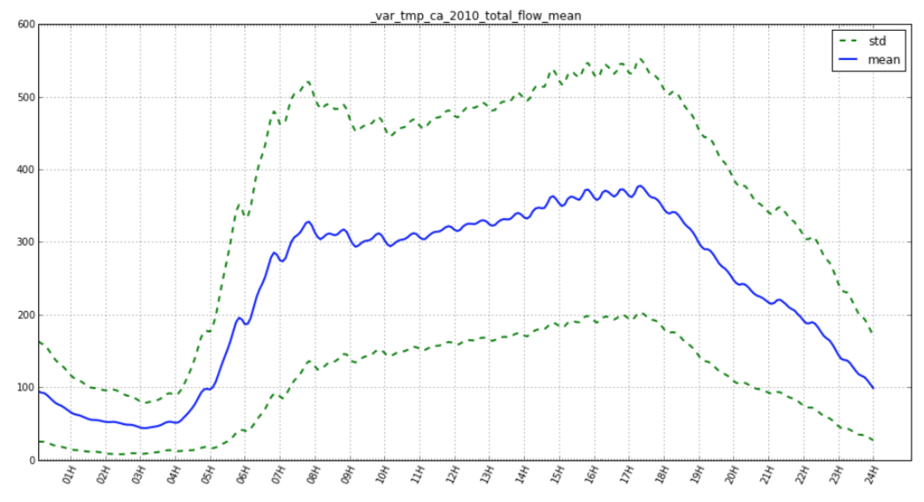
Mean and STD of total flow (cars per minute)

Slide 12
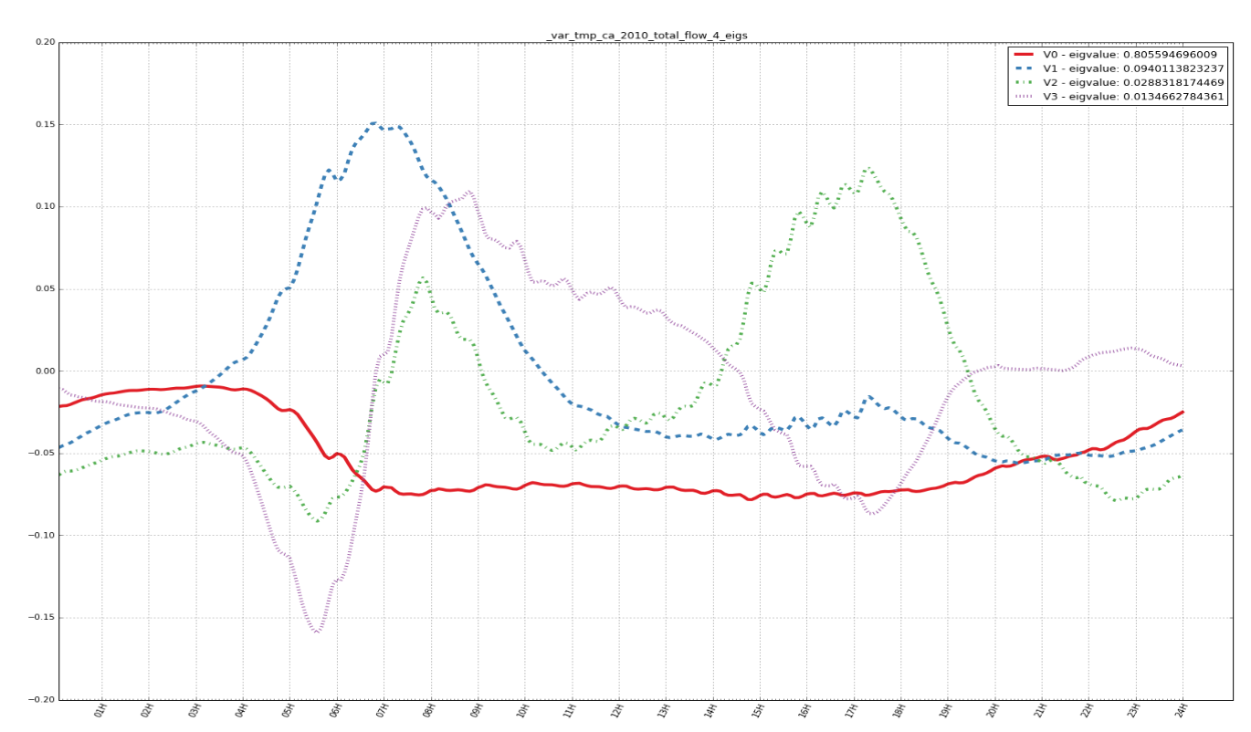
Top Eigen-vectors

